Slide 1
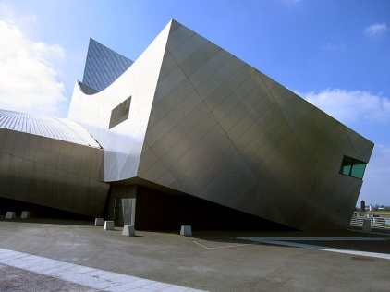
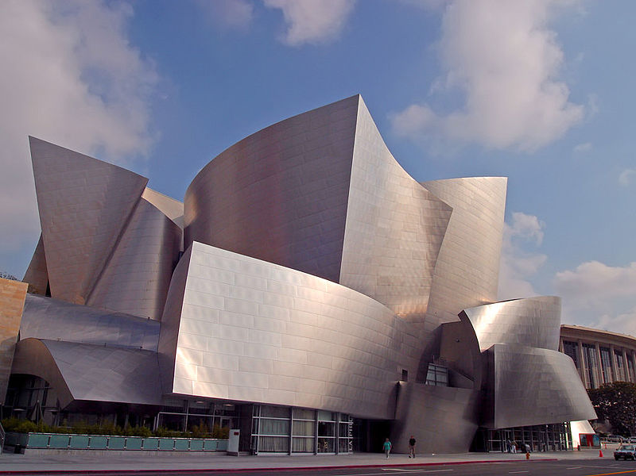
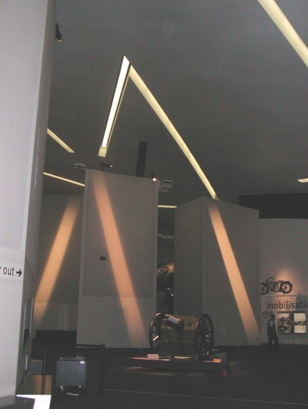
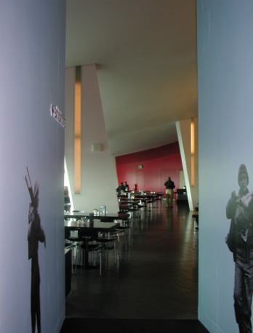
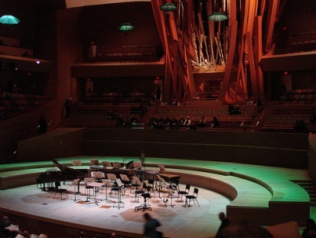
Deconstructivism in architecture, also called deconstruction, is a development of postmodern architecture that began in the late 1980s. It is characterized by ideas of fragmentation, an interest in manipulating ideas of a structure's surface or skin, non-rectilinear shapes which serve to distort and dislocate some of the elements of architecture, such as structure and envelope. The finished visual appearance of buildings that exhibit the many deconstructivist "styles" is characterised by a stimulating unpredictability and a controlled chaos.
Libeskind's Imperıal Museum,North in Manchester
The Walt Disney Concert Hall in Los Angeles,California

Slide 2

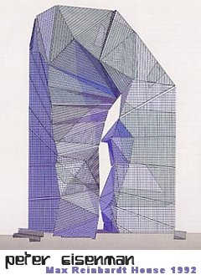
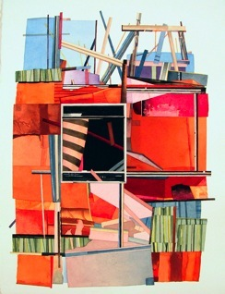
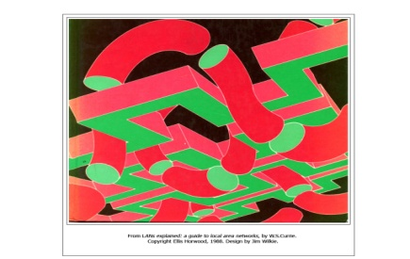
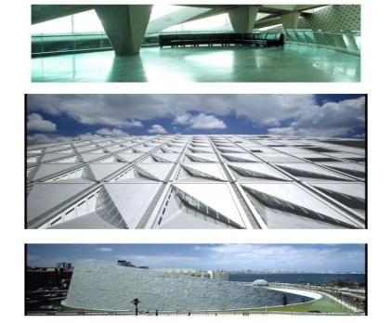
THE GENERAL CHARACTERISTICS OF DE CONSTRUCTIVISM
Explodes architectural form into loose collections of related fragments.
Destroys the dominance of the right angle and the cube by using the diagonal line..
Uses ideas and images from Russian Revolutionary architecture and design
Searches for more DYNAMIC spatial possibilities and experiences not explored (or forbidden) by the Modern Movement.
Provokes shock, uncertainty, unease, disquiet, disruption, distortion by challenging familiar ideas about space, order and regularity in the environment.
Rejects the idea of the `perfect form' for a particular activity and rejects the familiar relationship between certain forms and certain activities.
Note the work of the architects, Peter Eisenman, Bernard Tschumi and Zaha Hadid.

Slide 3
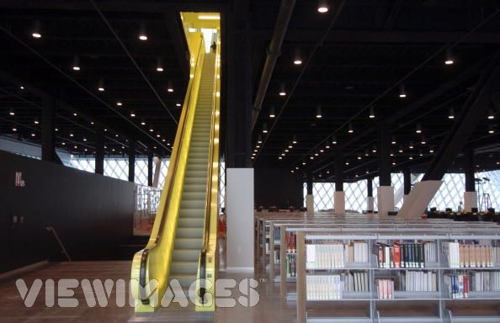
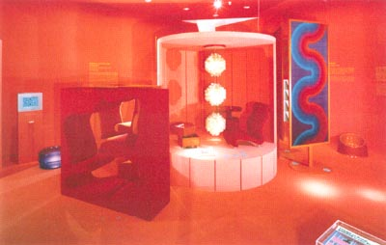
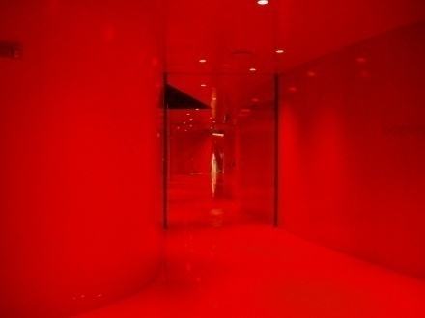
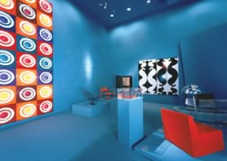
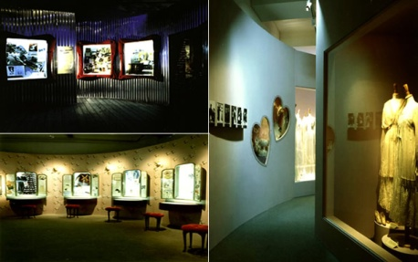
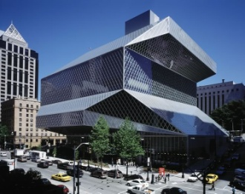
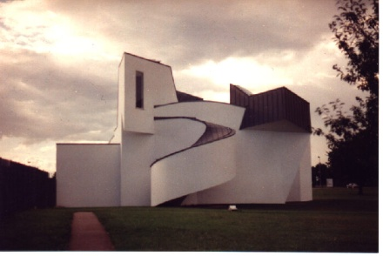
HISTORY OF DE CONSTRUCTIVISM
MODERNISM AND POST MODERNISM PERIOD
Deconstructivism in contemporary architecture stands in opposition to the ordered rationality of Modernism. Its relationship with Postmodernism is also decidedly contrary. Though postmodernist and nascent deconstructivist architects published theories alongside each other in the journal Oppositions (published 1973–84), that journal's contents mark the beginning of a decisive break between the two movements. Deconstruction took a confrontational stance toward much of architecture and architectural history, wanting to disjoin and disassemble architecture.[2] While postmodernism returned to embrace— often slyly or ironically—the historical references that modernism had shunned, deconstructivism rejects the postmodern acceptance of such references. .
Seattle Central Library by Rem Koolhas
Vıtra desıgn Museum by Frank Gehry

Slide 4
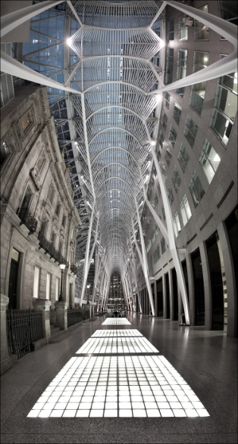
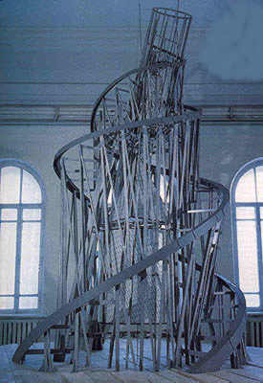
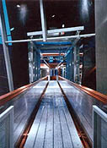
CONTEMPORARY PERIOD OF DE CONSTRUCTIVISM
Two strains of modern art, minimalism and cubism, have had an influence on deconstructivism. Analytical cubism had a sure effect on deconstructivism, as forms and content are dissected and viewed from different perspectives simultaneously. A synchronicity of disjoined space is evident in many of the works of Frank Gehry and Bernard Tschumi. Synthetic cubism, with its application of found art, is not as great an influence on deconstructivism as Analytical cubism, but is still found in the earlier and more vernacular works of Frank Gehry. Deconstructivism also shares with minimalism a disconnection from cultural references. It also often shares with minimalism notions of conceptual art.
UFA PALAST DRESDEN DESIGNED BY COOP HIMMELBAU

Slide 5
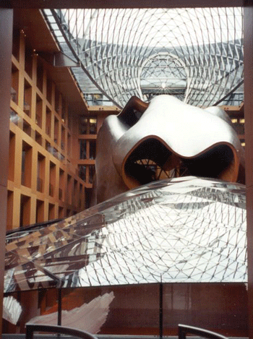
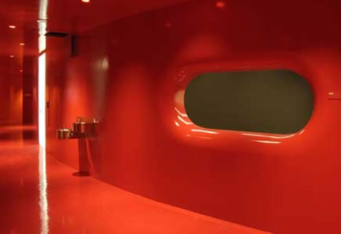
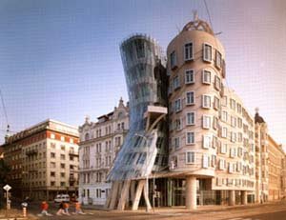
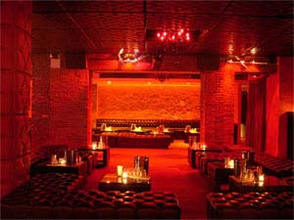
1988 MOMA EXHIBITION
Mark Wigley and Phillip Johnson curated the 1988 Museum of Modern Art exhibition Deconstructivist architecture, which crystallized the movement, and brought fame and notoriety to its key practitioners. The architects presented at the exhibition were Peter Eisenman, Frank Gehry, Zaha Hadid, Coop Himmelblau, Rem Koolhaas, Daniel Libeskind, and Bernard Tschumi. Mark Wigley wrote the accompanying essay and tried to show a common thread among the various architects whose work was usually more noted for their differences.
Dancıng House in Praque by Frank Gehry
The projects in this exhibition mark a different sensibility,one in which the dream of pure form has been
Disturbed.It is the ability to disturb our thinking about form that makes these project de constructive.
Philip Johnson and Mark Wigley,Excerpts From De Contructıvıst Archıtecture

Slide 6
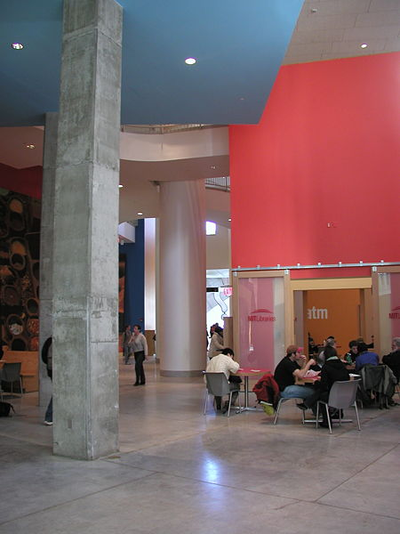
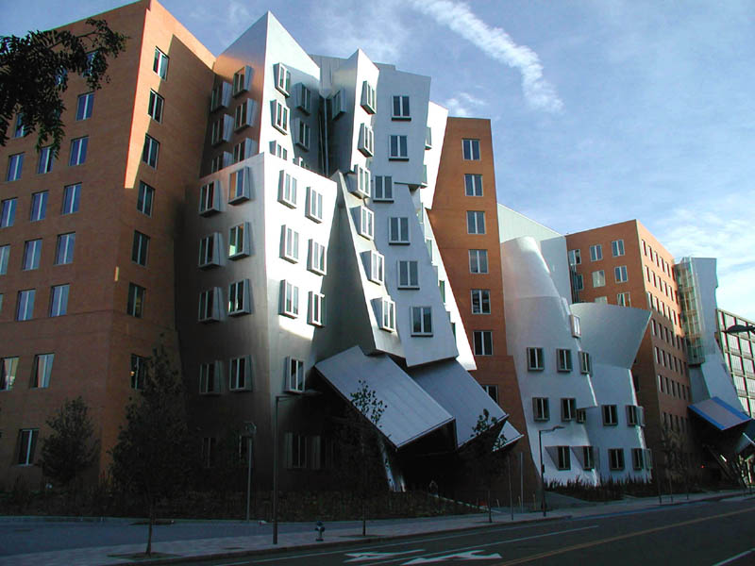
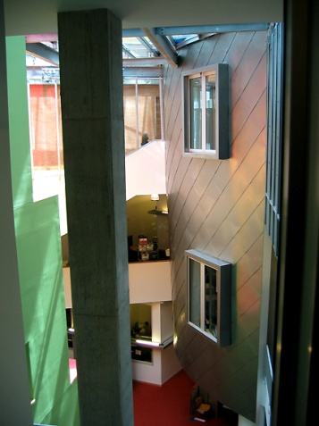
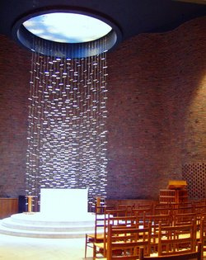
COMPUTER AIDED DESIGN IN DE CONSTRUCTIVISM
Computer aided design is now an essential tool in most aspects of contemporary architecture, but the particular nature of deconstrucivism makes the use of computers especially pertinen
Three-dimensional modelling and animation (virtual and physical) assists in the conception of very complex spaces.
Mıt Stata Center,opened march 16,2004
Gehry iS noted for producing many physical models as well as computer models as part of his design process.

Slide 7
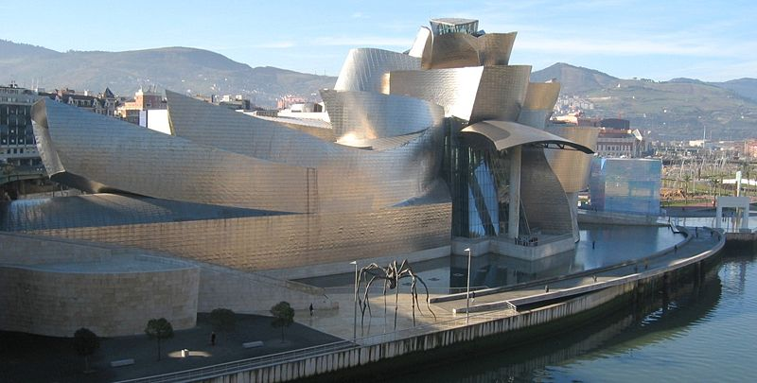
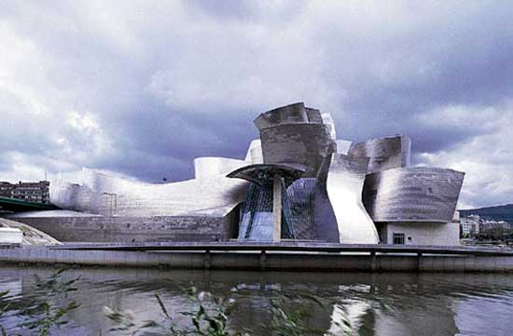
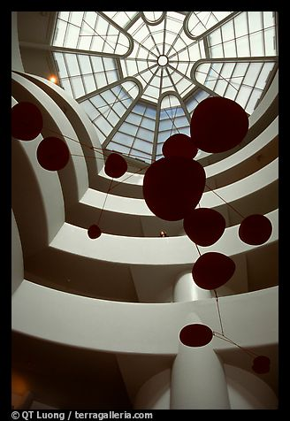
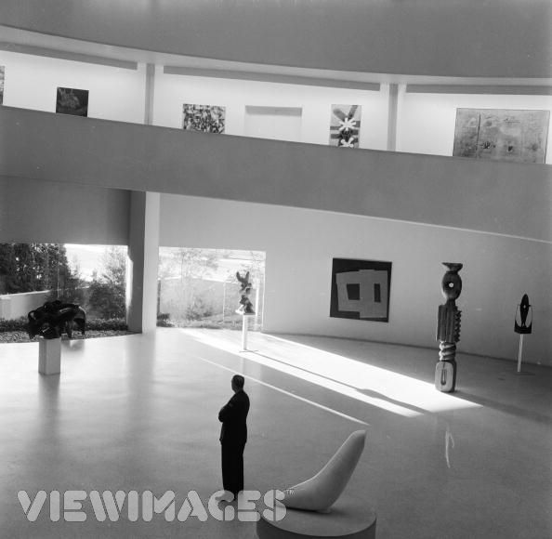
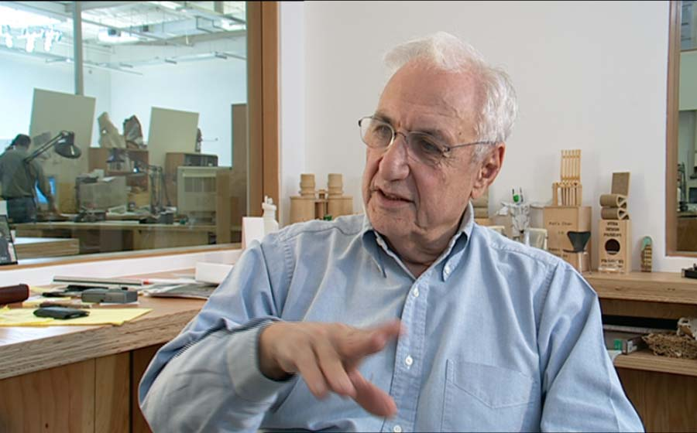
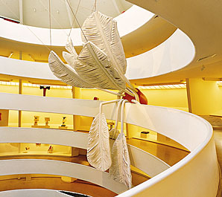
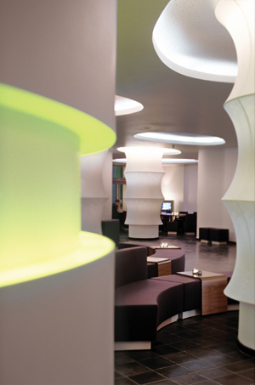
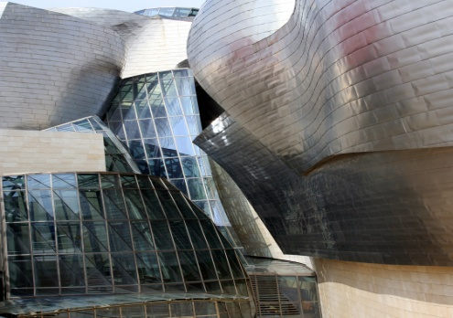
FRANK GEHRY
The Guggenheım Museum Bilbao by Frank Gehry, on the Nervión River in downtown Bilbao, Spain.
INTERIOR VIEW

Slide 8
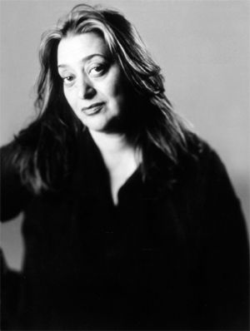
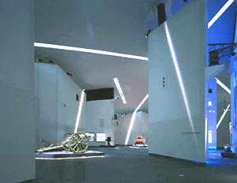
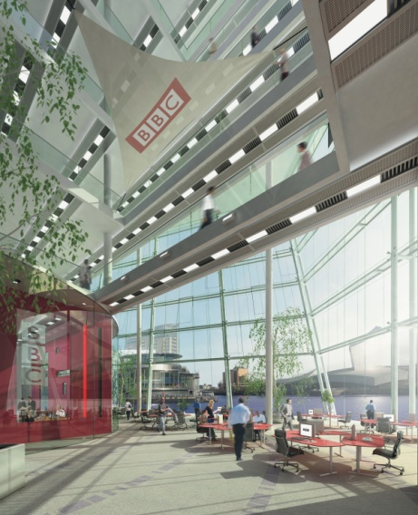
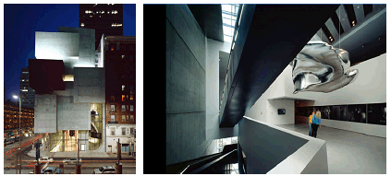
ZAHA HADID
Hadid's Art in Cincinnati, Ohio Rosenthal Centre for Contemporary Art in Cincinnati, Ohio

Slide 9
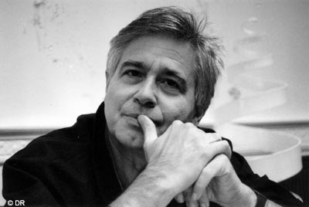
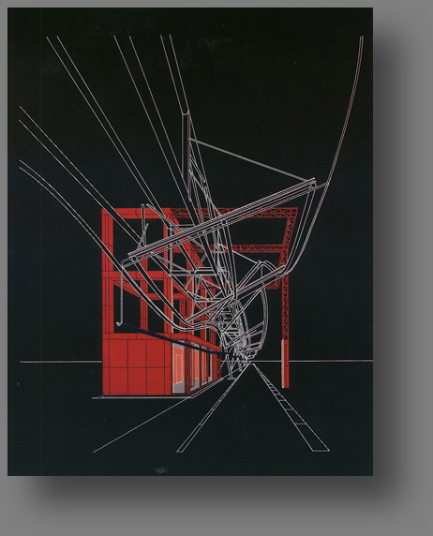
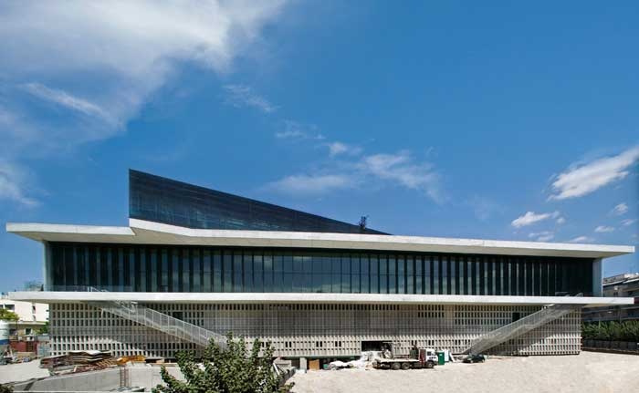
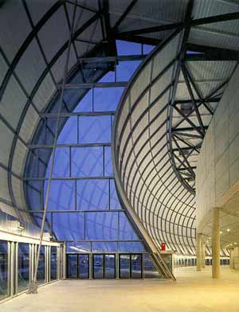
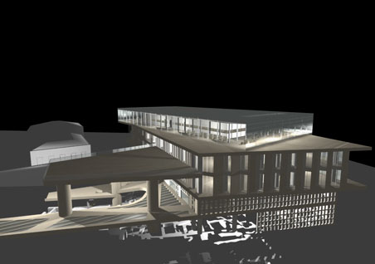
BERNARD TSCHUMI
NEW ACROPOLIS MUSEUM DESIGNED BY BERNARD TSCHUMI
EXTERIOR AND INTERIOR VIEW
3D MODEL

Slide 10
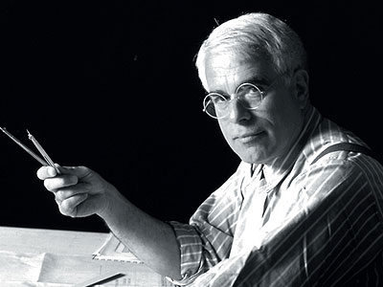
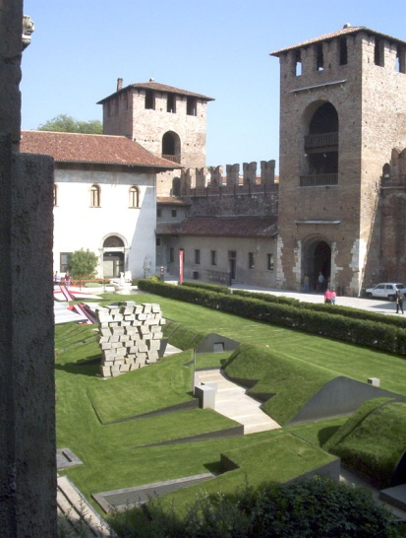
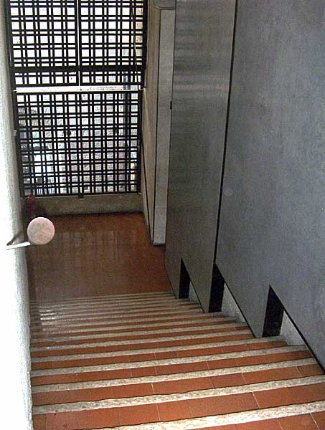
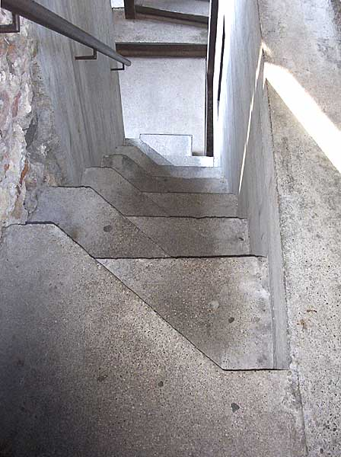
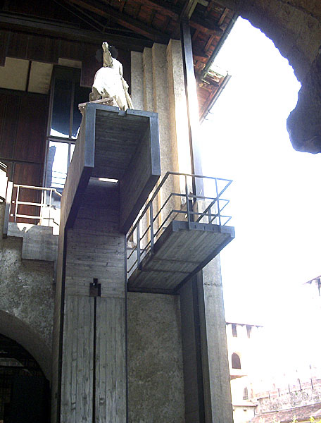
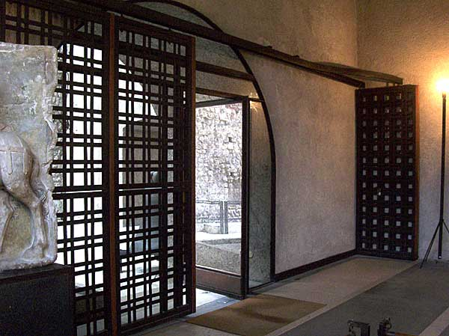
PETER EISENMANN
CASTELVECCHIO MUSEUM IN VERONA,ITALY DESIGNED BY PETER EISENMANN

